Slide 1
I Don’t Want an Interpreter
Andy Schwieter

Slide 2
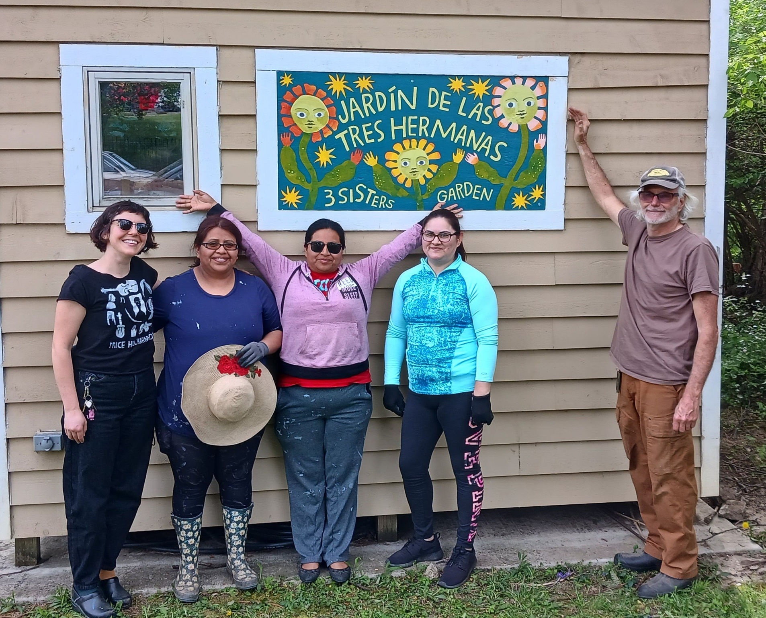
I don’t want an interpreter. It’s confusing. - Alejandra

Slide 3
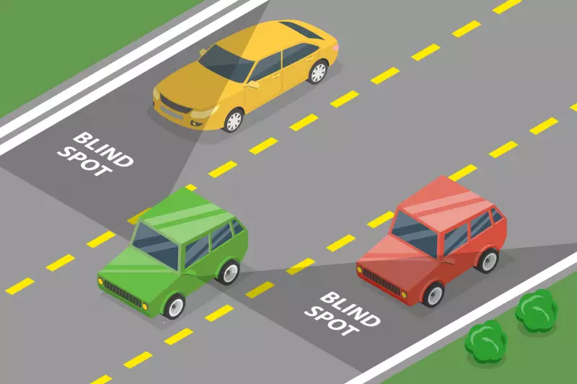

Slide 4
Declining Interpreters
Patient | “I want to speak in English” | “I want someone who came with me to by my interpreter."
Clinician | “I want to use [ASL, Spanish, Chinese, etc.] to communicate with the patient” | ”I want someone who came with the patient to be our interpreter.”

Slide 5
Map for this conversation
Many people feel this way.
It’s about trust, control, and power.
Interpreters can do something about it.

Slide 6
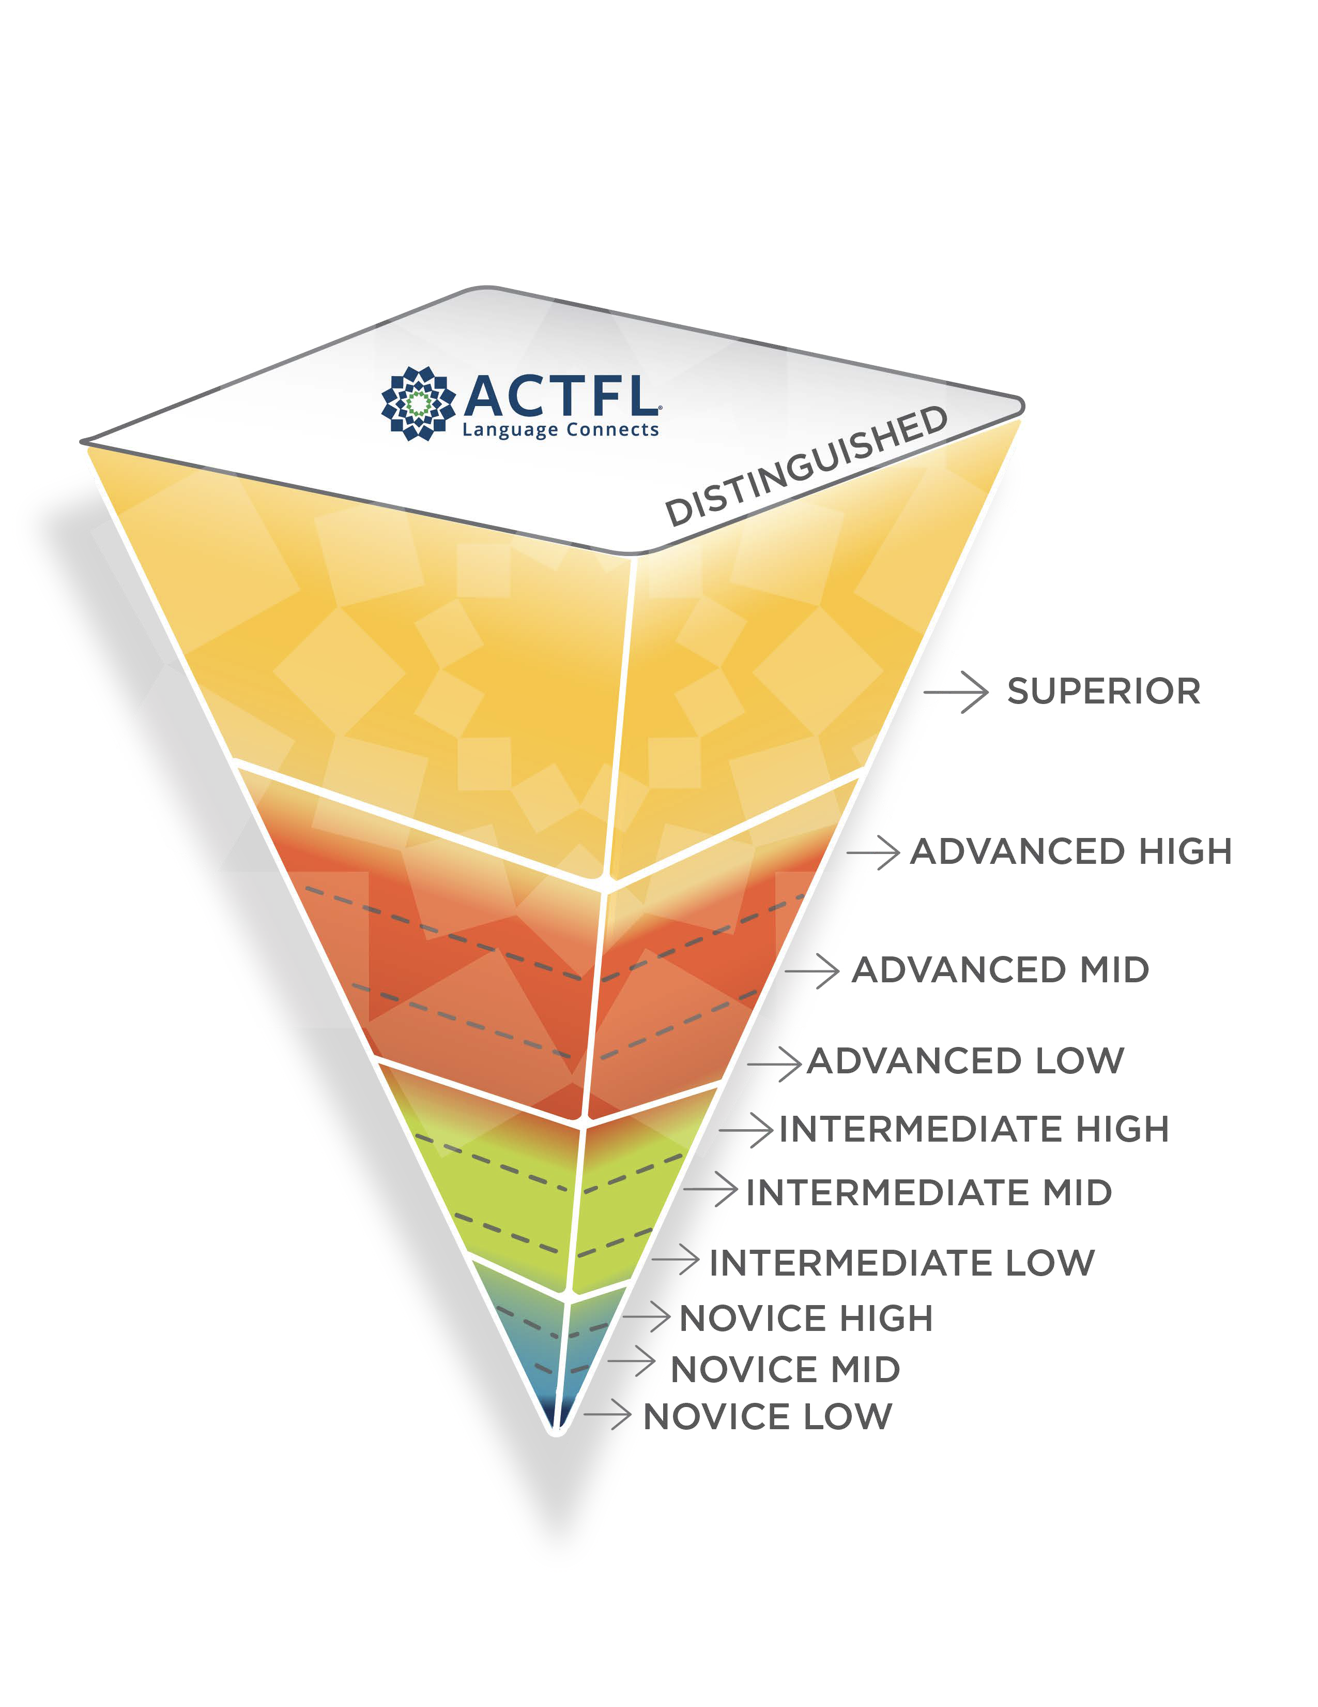
Language proficiency is a spectrum

Slide 7
Most people with LEP speak some English
U.S. Census Bureau. (2024). 2023 American Community Survey 1-Year Estimates Public Use Microdata Sample.

Slide 8
“I have had translators because I unfortunately cannot speak English.”
Schwei, R. J., Schroeder, M., Ejebe, I., Lor, M., Park, L., Xiong, P., & Jacobs, E. A. (2018). Limited English Proficient Patients’ Perceptions of when Interpreters are Needed and how the Decision to Utilize Interpreters is Made. Health Communication, 33(12). https://doi.org/10.1080/10410236.2017.1372047

Slide 9
“One knows more or less English and sees that when there is an interpreter it is as if the information does not arrive correctly.
And in one of the most important moments, which for me was prenatal care, one needs to be clear, with many doubts that one has.”
Salinas, K. E., Bazan, M., Rivera, L., Butler, H., Larson, E., Guise, J.-M., Hacker, M. R., Kaimal, A. J., & Molina, R. L. (2023). Experiences and Communication Preferences in Pregnancy Care Among Patients With a Spanish Language Preference: A Qualitative Study. Obstetrics and Gynecology, 142(5), 1227–1236. https://doi.org/10.1097/AOG.0000000000005369

Slide 10
Have you ever worked with an interpreter for a language you spoke a little or well but not very well ? What was it like?

Slide 11
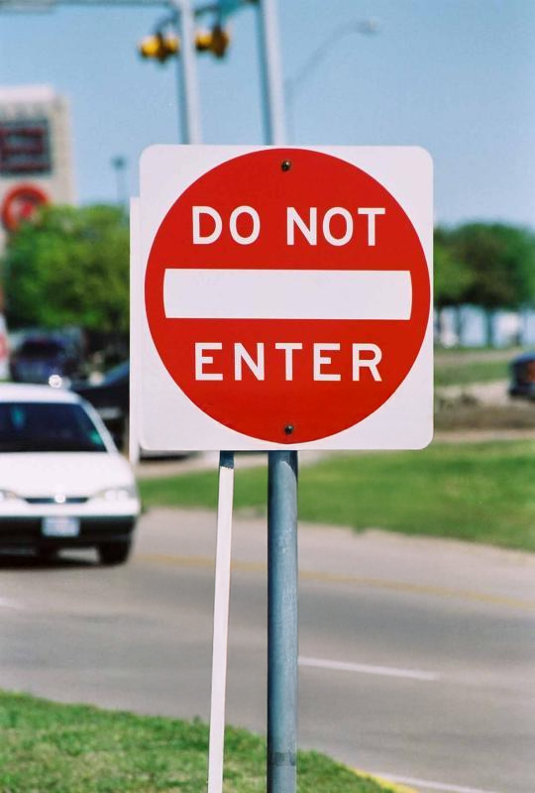

Slide 12
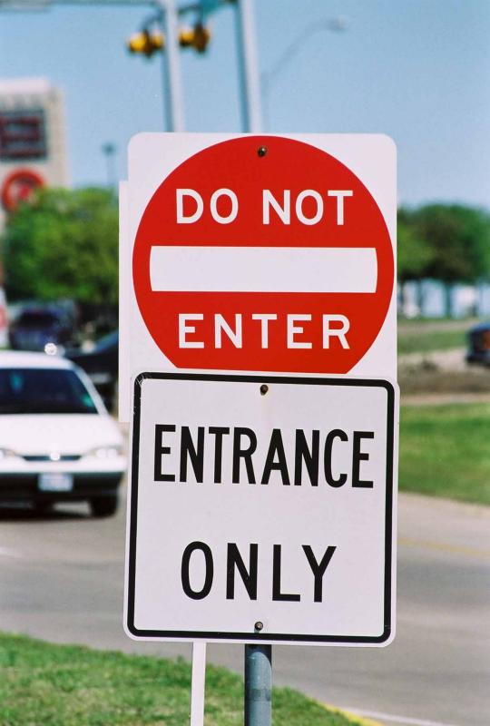

Slide 13
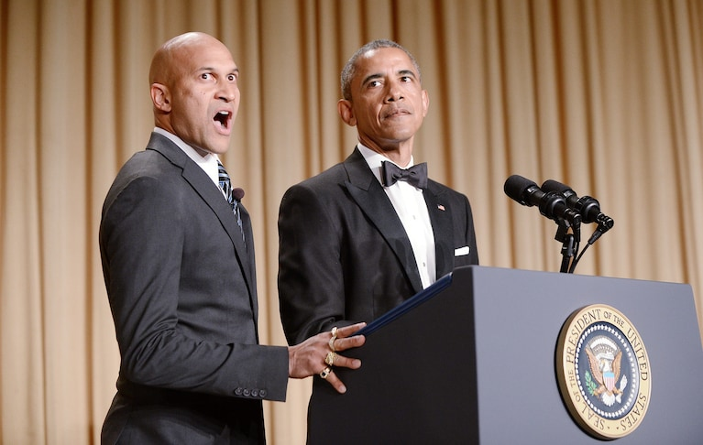

What do you do?
Clarify with the interpreter
Live with the confusion

Slide 14


Slide 15
Trust matters in healthcare.
“To pursue the patient's good, the patient must trust the physician (or clinician, or organization) with private information and with his/her body.
Trust in the healer is essential to healing itself.
Trust, at least to some minimal extent, is undoubtedly a prerequisite to seeking care at all.”
Goold, S. D. (2002). Trust, Distrust and Trustworthiness. Journal of General Internal Medicine, 17(1), 79–81. https://doi.org/10.1046/j.1525-1497.2002.11132.x

Slide 16
Difficulties come from issues around trust, control, and power.
Trust
Among the three (or more) protagonists
Control
The ability to orient the course of action during consultations and verify the accuracy and validity of what is said.
Power
Manifestations of broader power struggles in institutions and society, such as institutional constraints (time, cost) and lack of support for interpreters.
Brisset, C., Leanza, Y., & Laforest, K. (2013). Working with interpreters in health care: A systematic review and meta-ethnography of qualitative studies. Patient Education and Counseling, 91(2), 131–140. https://doi.org/10.1016/j.pec.2012.11.008
Notes:
How do these manifest in language discordant scenarios?
What about partially language concordant?

Slide 17
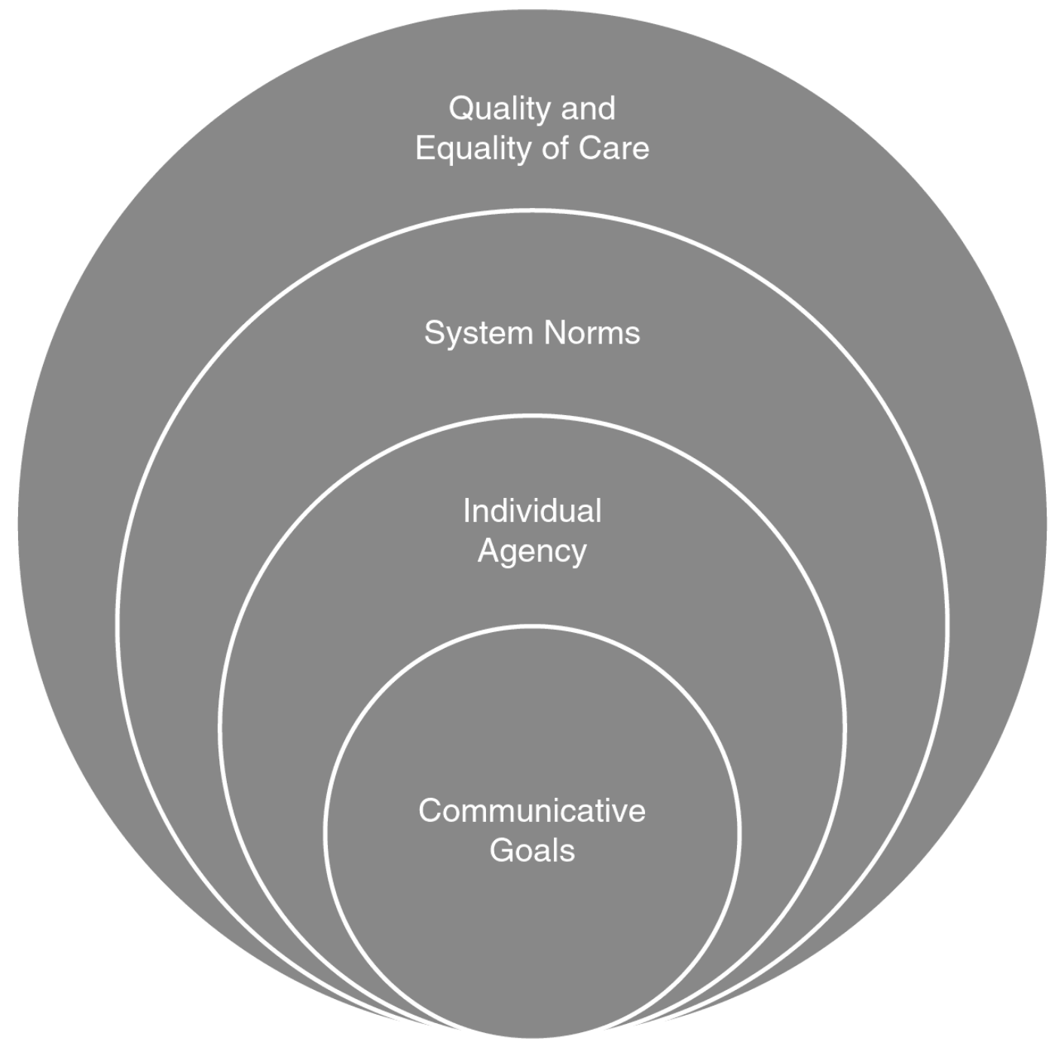
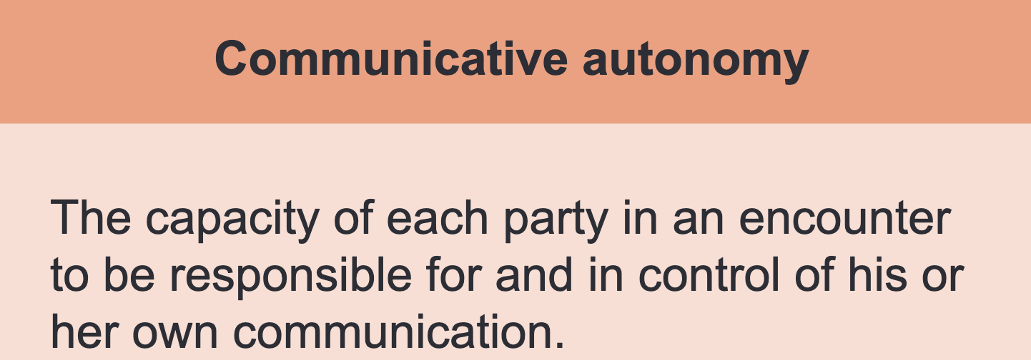
Goals

Slide 18

Ethical values
Beneficence
Fidelity
Respect for the importance of culture and cultural differences

Slide 19


Slide 20
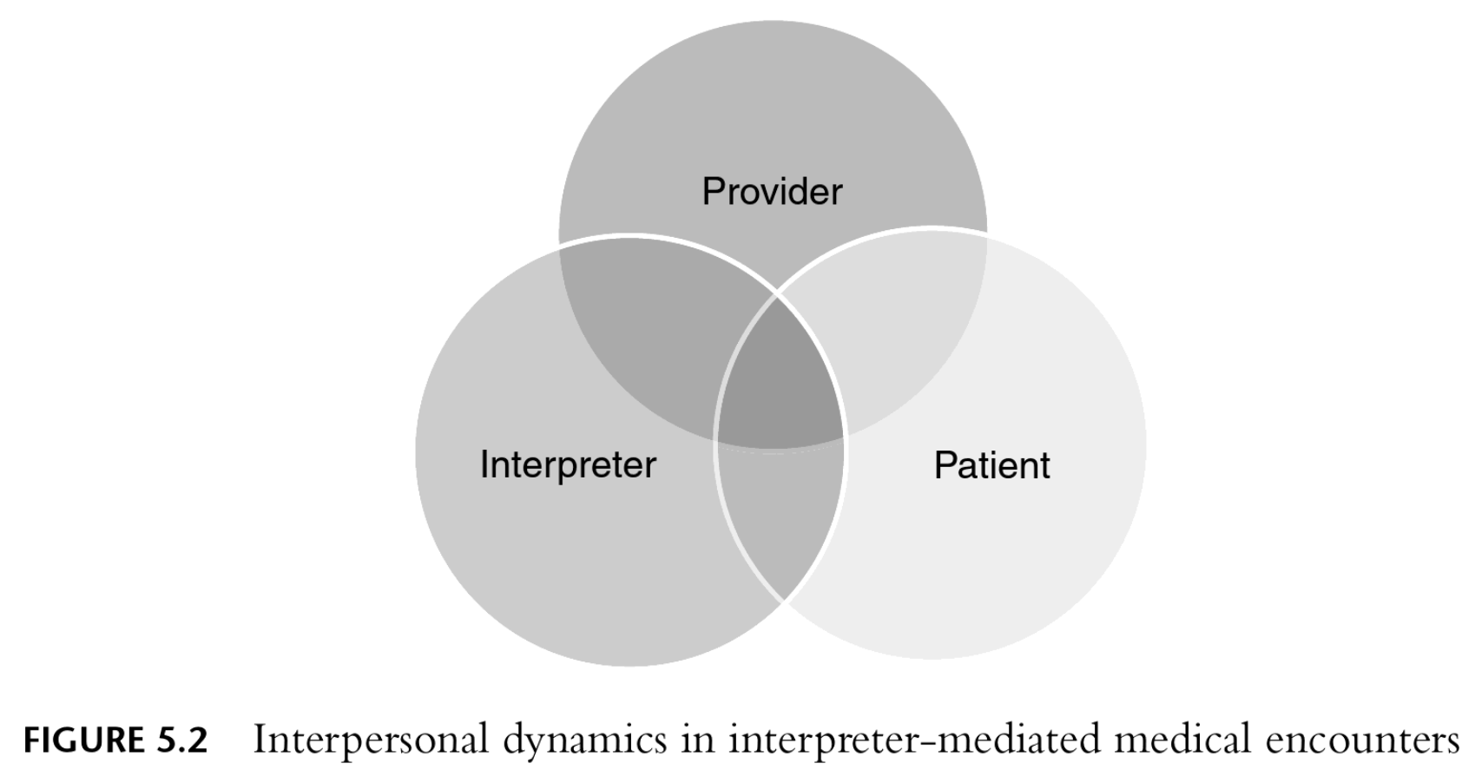
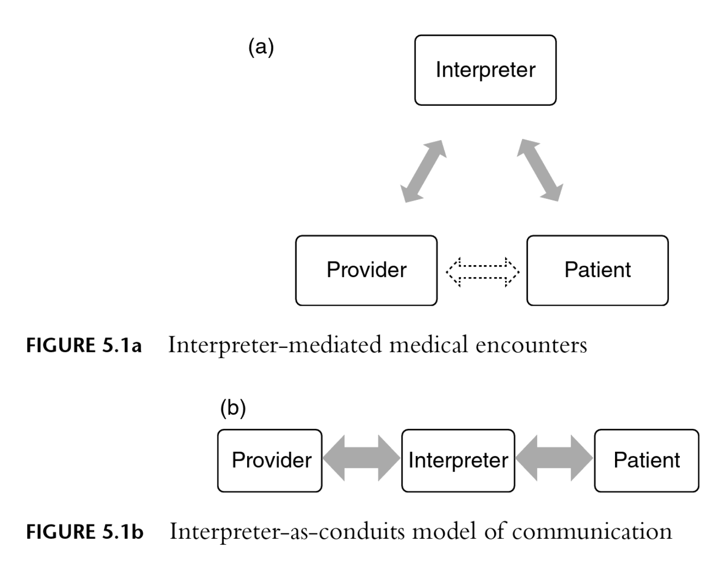
Hsieh, E. (2016). Bilingual Health Communication: Working with Interpreters in Cross-Cultural Care. Taylor & Francis Group. https://doi.org/10.4324/9781315658308

Slide 21
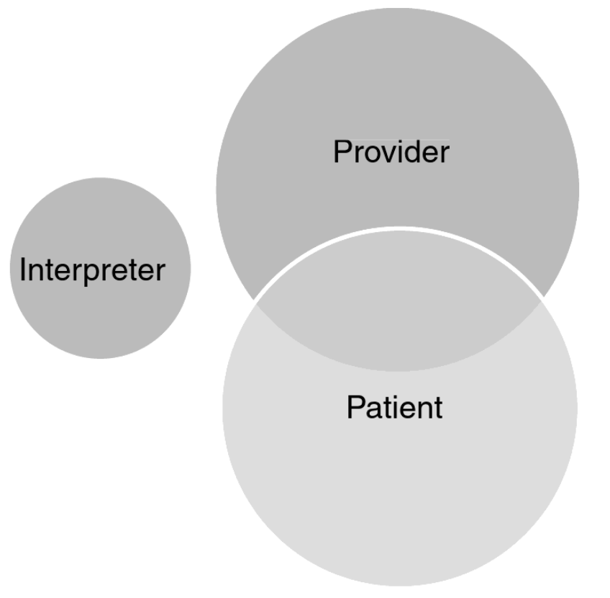
Language Discordant
Partially Language Concordant

Slide 22
What could interpreters do to help in partially language concordant sessions?
Human dictionary
Listen for possible misunderstandings, then intervene
When asked, do the bilingual parrot interpreting thing
Focus on identifying and addressing cultural issues or misunderstandings
Suggest teach-back when it might help

Slide 23
Many people who speak some English do not want an interpreter because they do not want to share trust, control, and power with a bilingual parrot.
Interpreters should help in a different way instead.

Slide 24
Session Codes
IMIA/NBCMI: CHIA26-22
CCHI: C2609AY

